Slide 1
Motion Prediction in Home Automation

Slide 2
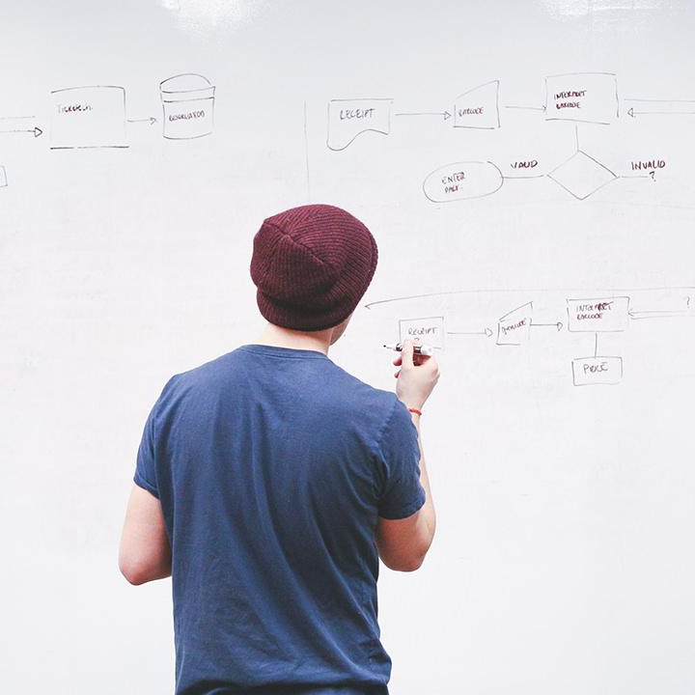
Team Members
Harsh Yadav (19csu121)
Isha Saluja (19csu131)
Himashi Dudeja (19csu125)
Ishita Garg (19csu139)

Slide 3
Project Idea
.
Security Surveillance is expensive and 24*7 surveillance by humans carries a very high operational cost and humans are also prone to errors during detection. Human activity detection can be done to recognize a set of human activities by training a supervised learning model and displaying the activity being done as a result as per the input activity received from the camera input.

Slide 4
Project Objectives
To prepare a dataset consisting of images for 6 activities namely walking, hand waving, squats, talking on the phone, standing and performing Meditation.
The dataset is segmented and the relevant data is annotated with labels of the above- mentioned activities.
Data is pre-processed and redundant and irrelevant data is edited out.
The development of an optimised model is carried out that uses Logistic Regression as a classifier to segment the dataset images into their respective action labels. This is done following a supervised learning procedure for training the model. The threshold is also set to determine the probability of correctness in the determination of the action being performed.
Demonstrating the results.

Slide 5
Libraries Will Use
Action AI
Tensor Flow
Open CV(Computer Vision)
Scikit Learn
Pandas
Numpy

Slide 6
ACTION AI
Action AI is a library proposed by python – 3.6. This library is most significantly used to recognize and segregate the human actions by developing Machine Learning algorithms for training a model that identifies different human actions .

Slide 7
Tensor Flow
TensorFlow 2.0 is an open-source library that has its significance in development and training of Machine Learning models. It can be implemented on various programming languages. It has a large set of software libraries that handles flow of data across various systems, applications and tasks. One of the biggest implementations of Machine Learning algorithms, i.e.; Neural Networks can be implemented using TensorFlow. We are using 2.0 version of TensorFlow mainly due to additional inbuilt functions available in this version as compared to the previous versions.

Slide 8
Open CV
Open Source Computer Vision Library commonly known as OpenCV is a collection of programming functions which is prominently used for Real time Computer Vision. As the name states, it is commonly used for capturing video’s or images live.

Slide 9
Scikit-Learn
Sklearn can be implemented in association with many Python Libraries such as Pyplot and Matplotlib for plotting, Array Vectorization using Numpy, Extracting dataframes using Pandas,Scipy and many other libraries.

Slide 10
Pandas
Pandas is a Python programming language software library for data processing and analysis. In specific, it includes data structures and procedures for the analysis of numerical tables and time series.

Slide 11
Numpy
Numpy is a software library mainly used for Array Vectorization. It is implemented using Python programming language. It supports large multidimensional arrays and matrices.

Slide 12
Dataset
Dataset include videos of each activity

Slide 13
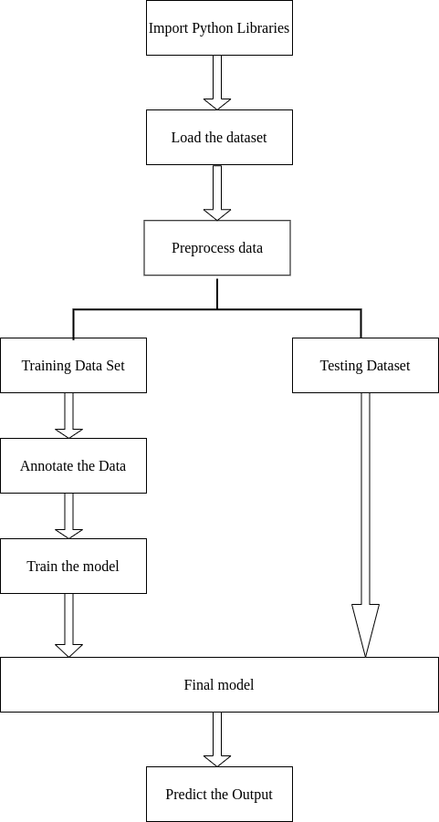
Data Flow Diagram

Slide 14
Expected Output
Test case id | Description | Input video | Expected output | Actual output | Result
1 | Walking in room | Person walking 1 | Walking | Walking | pass
2 | Slow walking on street | Person walking 2 | Walking | Walking | pass
3 | Hand in pocket while walking | Person walking 3 | Walking | Walking | pass
4 | Wearing skullcap and jacket | Person walking 4 | Walking | Walking | pass

Slide 15
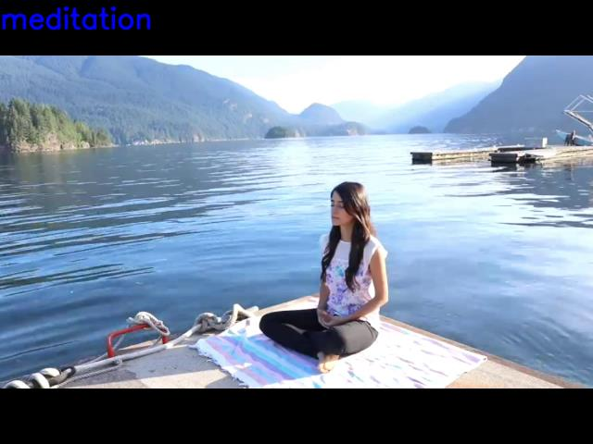
Expecting Output
The output of human activity is displayed over the playback of the video in real time on the top left corner of the screen. It keeps on changing based on the activity being performed at that instance of the video being played.
Results for Meditation activity

Slide 16
References
https://teachablemachine.withgoogle.com/
https://www.google.com/imghp?hl=en
https://www.youtube.com/
https://www.kaggle.com/datasets

Slide 17
THANK YOU!

